Slide 1
Ransomware Lab

Slide 2
Ransomware Lab
Materials needed
Kali Linux Virtual Machine
Windows 7 Virtual Machine
Software tool used (from Kali Linux)
theZoo Malware Repository
Note: This lab will not actually move/delete all the user’s files
Please note: You will need to reset the Environments after this lab

Slide 3
Objectives Covered
Security+ Objectives (SY0-501)
Objective 1.1 – Given a scenario, analyze indicators of compromise and determine the type of malware
Ransomware
DHS CAE Units
CTH – Describe different types of attacks and their characteristics

Slide 4
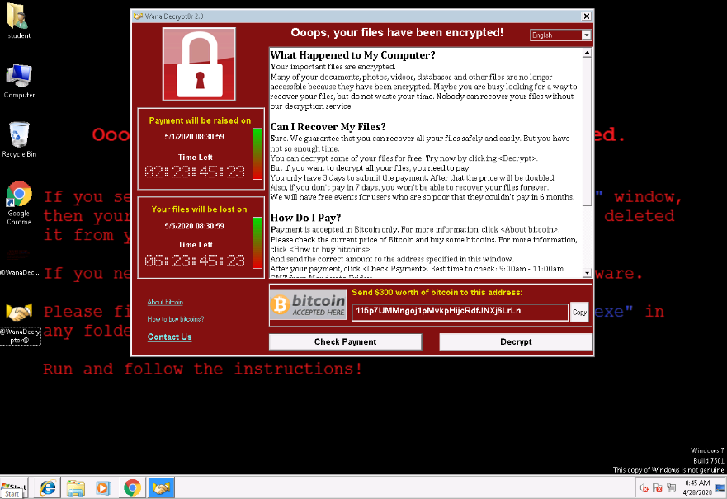
What is a Ransomware Attack?
Ransomware is an example of malware where the attacker’s request payment with a threat
The attacker can hide/encrypt all of the victim’s files and request payment to get access back to them
The attacker can threaten to release the victim’s data to the public if they don’t pay
Typically the attack is carried out via a trojan
This lab will hide the ransomware as a trojan
Ransomware that tells a user their files have been encrypted and must pay in $300 worth of bitcoin

Slide 5
The Ransomware Lab
Setup VM environment
Find the IP Address
Download the Malware Repository
Get the Ransomware File
Place the Trojan
Playing the Victim

Slide 6
Setup Environments
Log into your range
Open the Kali Linux and Windows 7 Environments
You should be on your Kali Linux Desktop
You should also be on your Windows 7 Desktop

Slide 7

Find the IP Address (Kali Machine)
You will need the IP address of the Kali machine
Open the Terminal
In the Linux VM, open the Terminal and type the following command:
hostname -I
This will display the IP Address
Write down the Kali VM IP address
The IP Address

Slide 8
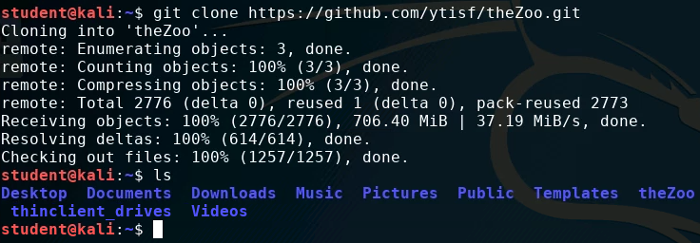
Download the Malware Repository
Download theZoo Malware Repository
git clone https://github.com/ytisf/theZoo.git
Verify the repository downloaded
ls
The Repository

Slide 9
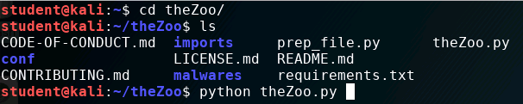
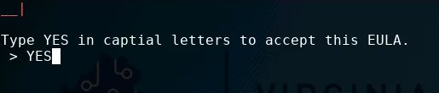

Get the Ransomware File
Navigate into theZoo directory
cd theZoo
Use ls to see the contents of theZoo directory
Open theZoo Repository
python theZoo.py
Type “YES” when prompted
You should see the mdb #> prompt
You are in theZoo Repository
In the Repository

Slide 10
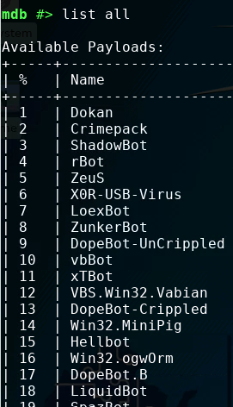
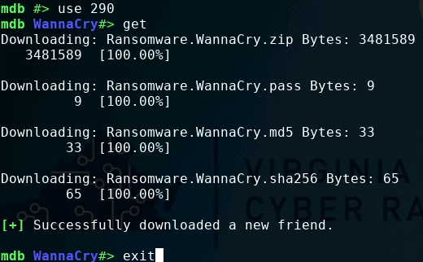
Get the Ransomware File
List all the possible payloads
list all
Find the “WannaCry”* Ransomware
Note the WannaCry ID Number (might be #290)
Open the WannaCry Ransomware
Use WannaCry-ID-Number
Download the files
get
Exit out of theZoo Repository
exit
*Please note there is also a WannaCry+ and WannaPeace malware

Slide 11
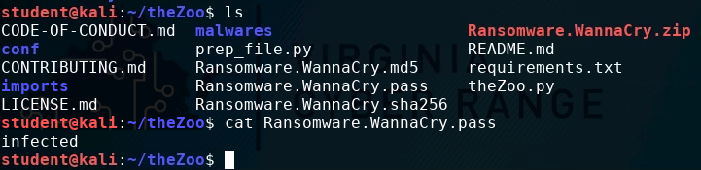
Get the Ransomware File
Verify the files downloaded
ls
Get the Ransomware.WannaCry password
cat Ransomware.WannaCry.pass
The password should be “infected”
You should see Ransomware.WannaCry files
Password

Slide 12
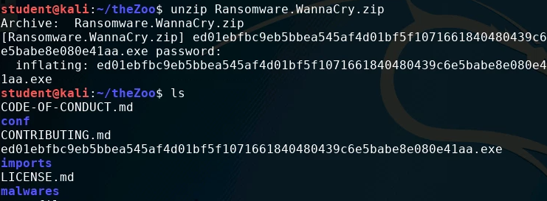
Get the Ransomware File
Unzip the Ransomware Files (this will be the Ransomware file)
unzip Ransomware.WannaCry.zip
Enter the password when prompted (password should be “infected”)
Verify the file (will be a long string of characters)
ls
The Ransomware File

Slide 13
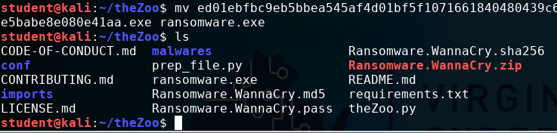
Place the Trojan
Rename the file as a ransomware.exe
mv ed01(<TAB> to autofill) ransomware.exe
Verify the file was renamed
ls
The Ransomware File renamed

Slide 14
Place the Trojan
Move the trojan/ransomware to the html files (for Apache2 server)
sudo mv ransomware.exe /var/www/html
Start the Apache2 server
sudo service apache2 start

Slide 15


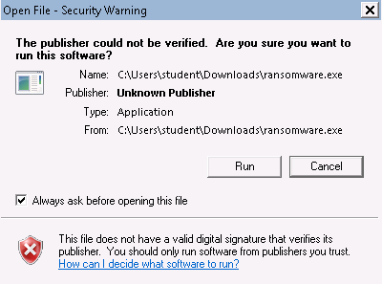
Playing the Victim
Open the Windows Environment
Open a web browser
Navigate to Kali-IP-Address/ransomware.exe
This should download the ransomware
Chrome will try to block the file
Allow the download
Click and run the executable file
Select “run” when prompted
Select “Run”

Slide 16
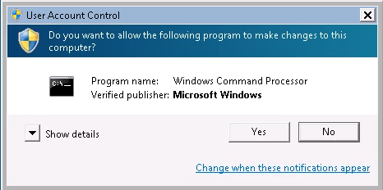
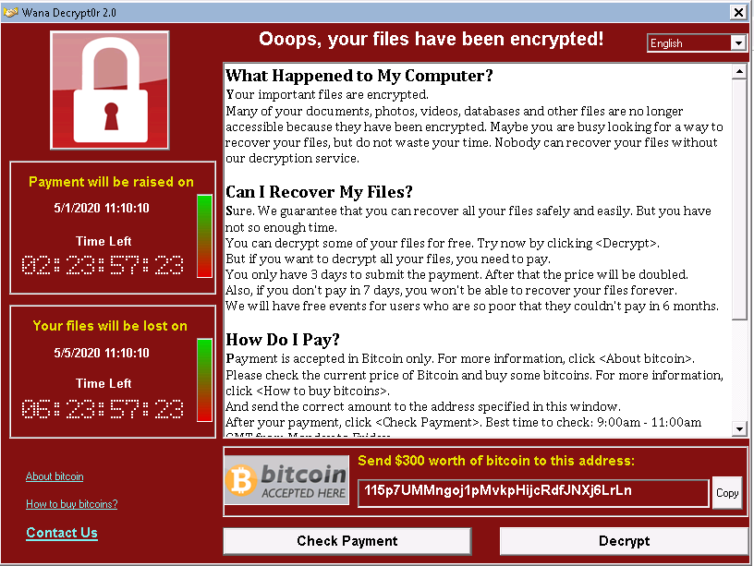
Playing the Victim
Select “Yes”
Select “yes” when prompted
You should notice the Ransomware activated on the screen now!

Slide 17
Playing the Victim
Please note this ransomware did not actually get rid of any files
This would take a lot more work to actually perform
What was the mistakes the victim made?
Try to remove the ransomware

Slide 18
Defend Against Ransomware
Do not click or run executable files from untrusted sources!
What were the mistakes the Victim made here?
What are some other ways of defending against a Ransomware attack?

